Slide 1

The Future of Medicine and Healthcare
By Malachi Hofer

Slide 2
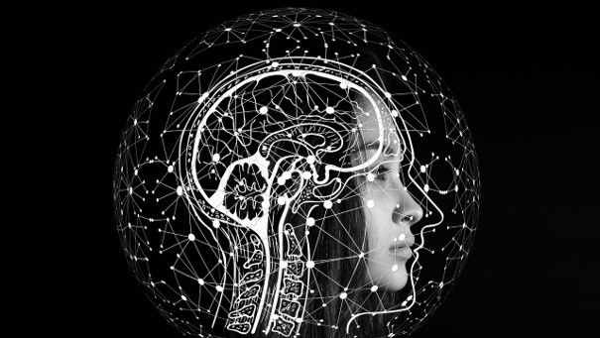

Slide 4

Jobs in danger
Safe jobs
Writers
Retail workers
Receptionists
Pharmacists
Musicians
Lawyers
Psychologists
Priests
Teachers
Doctors (somewhat)
Jobs at risk
Work that requires operating a vehicle
Some Computer Scientists

Slide 5
Robots replacing humans?
Here’s what we know
Jobs in danger
Jobs at risk
Safe jobs
Writers
Retail workers
Receptionists
Pharmacists
Work that requires operating a vehicle
Some Computer Scientists
Musicians
Lawyers
Psychologists
Priests
Teachers
Doctors (somewhat)

Slide 6
Robots replacing humans?
Here’s what we know
Jobs in danger
Jobs at risk
Safe jobs
Writers
Retail workers
Receptionists
Pharmacists
Work that requires operating a vehicle
Some Computer Scientists
Musicians
Lawyers
Psychologists
Priests
Teachers
Doctors (somewhat)
In the previous slide I included a list of careers that might be taken over by AI or robots. Doctors were safe, with the sidenote, “somewhat”. It is unlikely a robot could fully replace a doctor as they would not only need to memorize everything, but also be able to locate things in different people as not everyone is the same. To do this, they would need some sort of visual sight. Another problem would be that robots, unless programmed, aren’t very adaptive to their circumstances. So if something were to change, or a problem/complication were to rise, its unlikely they would be able to deal with the situation. Moreover, its possible that humans could use robot limbs to help perform surgeries. Also, artificial intelligence could help us with diagnosis and prescriptions because they can pinpoint things with likely 100% accuracy and there is no risk of human error.

Slide 7
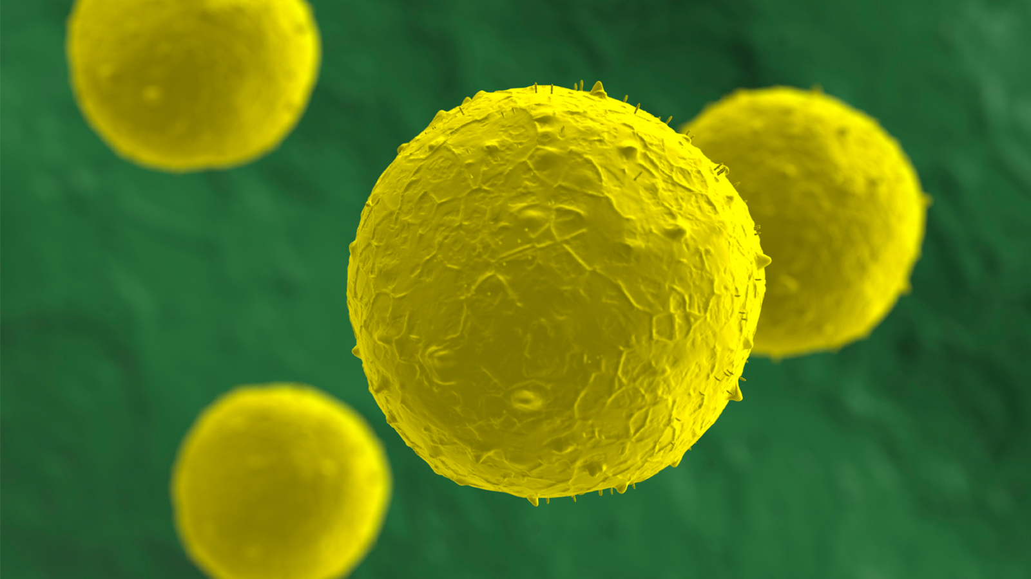
\

Slide 8
\

Slide 9

In this following explanation I am going to describe stem cells as well as nanotechnology because they are quite related and often paired. Stem cells are cells that have the capability to multiply and turn into a variety of different cells based on their environment. This is primarily used for treating cancer and other diseases like alzheimer’s, arthritis, and blindness. Nanotechnology means technology less than 100 nanometers, in short, very, very small. In medicine, they will create small nano devices that will carry out specific tasks. Like to deliver stem cells to a certain part of your body, for instance. Other tasks they would be able to do includes de-clogging your arteries or going into your bloodstream and either removing or supplying something (For example, Iron, if you were deficient).

Slide 10
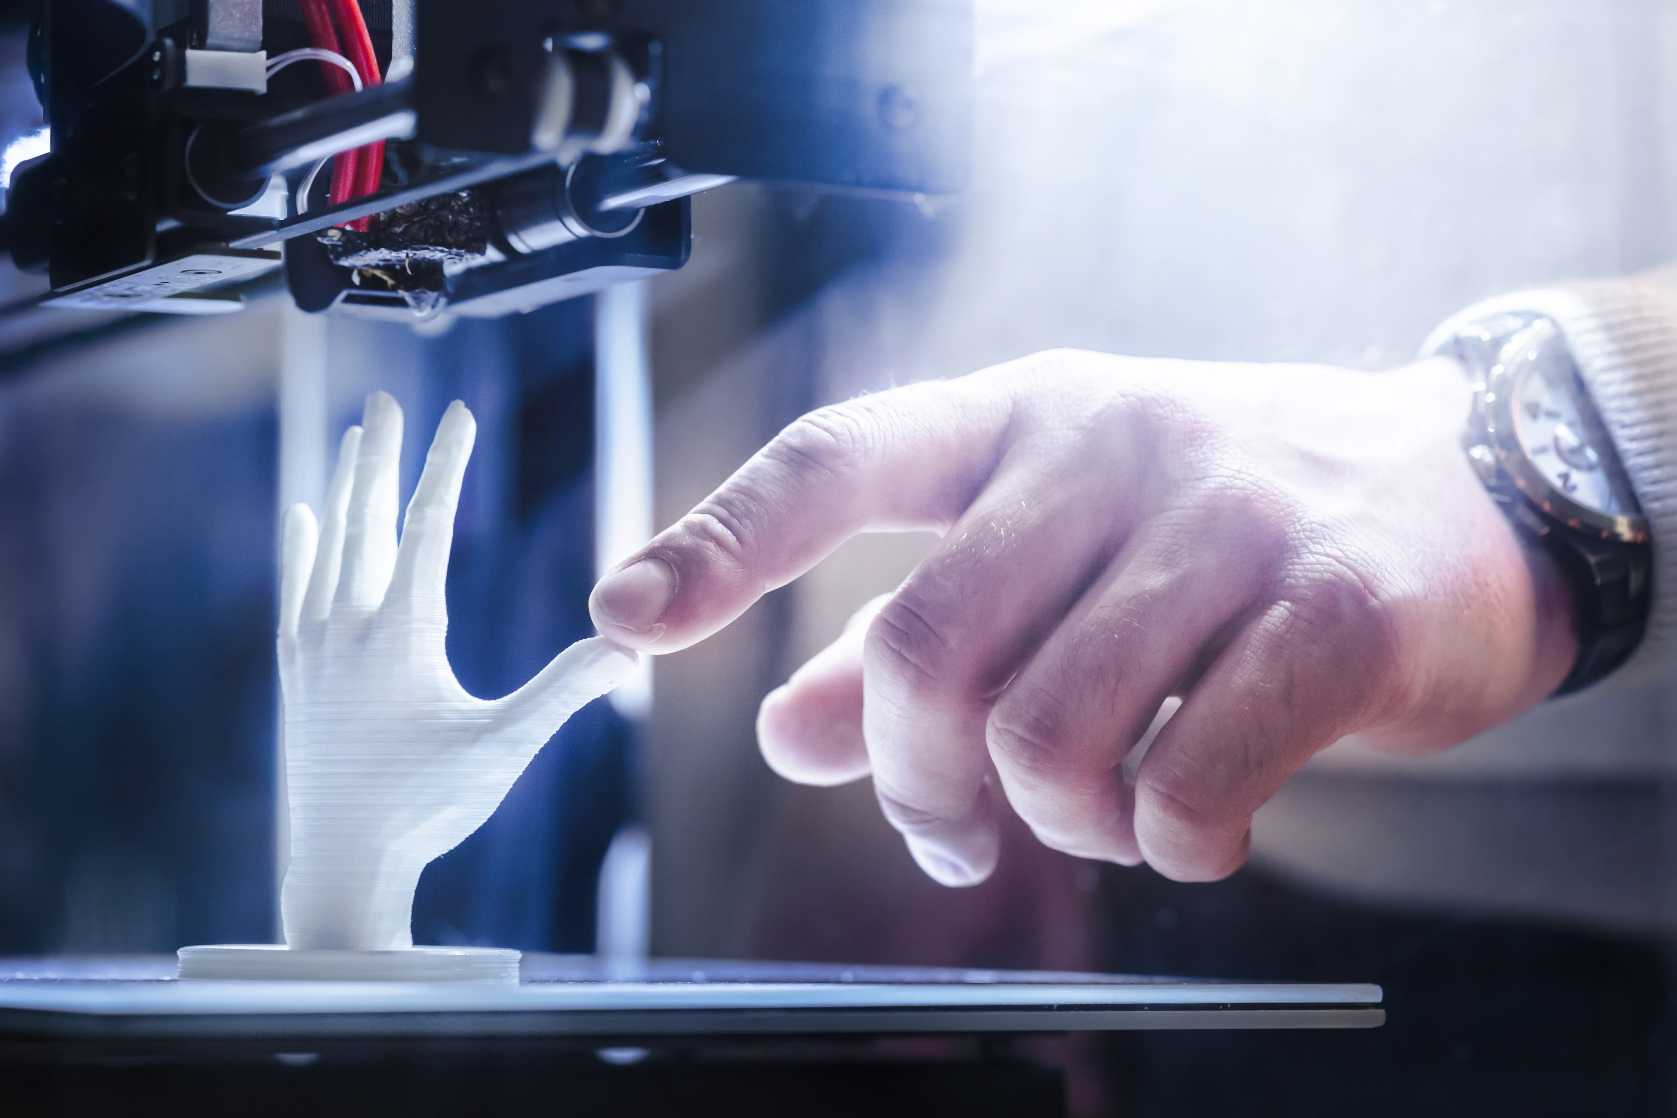

3D Printing has the potential to be a revolutionary technology and change the way that modern healthcare functions. With futuristic 3d printing it’s possible to create many different things. We would be able to replace and fix joints because we would be able to fully customize and design it with very high precision with very little cost. This is very important because its our joints that control the movement of different limbs. For instance, the knee and hip are responsible for the turning of the leg, the shoulders for the arm, etc. Not to mention, with 3d printing we could create hypothetically, anything, if we have the required materials. Eventually, we may even be able to 3d print organs that we could then use for transplants by connecting it back to the nerves, blood vessels, etc. Another massive benefit of 3d printing in healthcare is that its much faster. Prosthetic limbs take a long time obtain, and if you’re looking for an organ it could take years. By cutting time and cost, we would be able to help/service way more people. Moreover, dental industries have been using 3d designing/simulating for a long time. As well as some 3d printing, but in the future, dentistry's will be able to create braces, crowns, etc with 3d printing nigh-effortlessly.
3D Printing

Slide 11
3D Printing has the potential to be a revolutionary technology and change the way that modern healthcare functions. With futuristic 3d printing it’s possible to create many different things. We would be able to replace and fix joints because we would be able to fully customize and design it with very high precision with very little cost. This is very important because its our joints that control the movement of different limbs. For instance, the knee and hip are responsible for the turning of the leg, the shoulders for the arm, etc. Not to mention, with 3d printing we could create hypothetically, anything, if we have the required materials. Eventually, we may even be able to 3d print organs that we could then use for transplants by connecting it back to the nerves, blood vessels, etc. Another massive benefit of 3d printing in healthcare is that its much faster. Prosthetic limbs take a long time obtain, and if you’re looking for an organ it could take years. By cutting time and cost, we would be able to help/service way more people. Moreover, dental industries have been using 3d designing/simulating for a long time. As well as some 3d printing, but in the future, dentistry's will be able to create braces, crowns, etc with 3d printing nigh-effortlessly.
3D Printing

Slide 12
3D Printing has the potential to be a revolutionary technology and change the way that modern healthcare functions. With futuristic 3d printing it’s possible to create many different things. We would be able to replace and fix joints because we would be able to fully customize and design it with very high precision with very little cost. This is very important because its our joints that control the movement of different limbs. For instance, the knee and hip are responsible for the turning of the leg, the shoulders for the arm, etc. Not to mention, with 3d printing we could create hypothetically, anything, if we have the required materials. Eventually, we may even be able to 3d print organs that we could then use for transplants by connecting it back to the nerves, blood vessels, etc. Another massive benefit of 3d printing in healthcare is that its much faster. Prosthetic limbs take a long time obtain, and if you’re looking for an organ it could take years. By cutting time and cost, we would be able to help/service way more people. Moreover, dental industries have been using 3d designing/simulating for a long time. As well as some 3d printing, but in the future, dentistry's will be able to create braces, crowns, etc with 3d printing nigh-effortlessly.
3D Printing

Slide 13

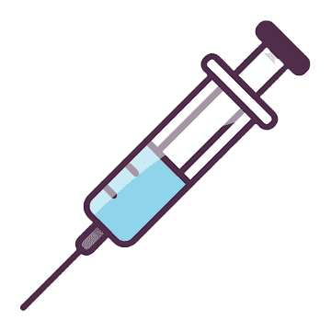
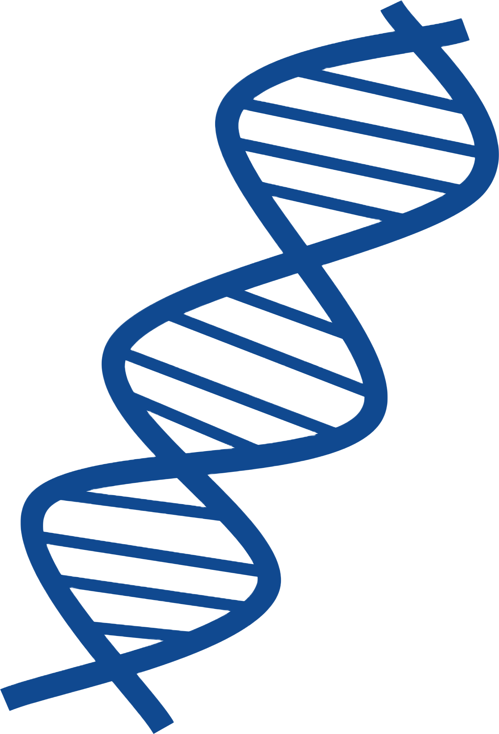
Quantum Computing

Slide 14
Quantum Computing

Slide 15

Quantum computing is perhaps one of the most important technologies for the future of healthcare, yet simultaneously, one of the least talked about. Quantum computers are among the post powerful in the world. They are able to display every possible value of a complex problem, as well as a minimum and maximum of costs and other variables like time. They could solve many problems in supply chains, especially within drug medicine. This is largely due to a thing called “qubits” which can exist as multiple 0 and 1’s simultaneously, while normal bits can only represent a single 0 or 1 value. Another valuable element, and one more simplistic, is the simulation of electrons inside of a molecule that can be manipulated in order to create new drugs or compounds. And finally, they can improve our existing data and find patterns in information that normal computers couldn’t.

Slide 16

Conclusion
This is only a fraction of the technology that will be implemented in the future, however, the ones I shared are among the biggest and most important. Even within 20 years, I suspect we will have AI fully diagnosing and prescribing. Our data and patterns will be optimized and complex problems like cost with the respect of time and effort may also be solved due to quantum computing. Moreover, 3d printing will also contribute to the problem by helping to optimize time and cost for joint replacements, prosthetics, and organs. And lastly, nanotechnology will be able to deliver stem (and other cells) to our blood, organs, etc. in order to cure, supply, or regulate us.

